Slide 1
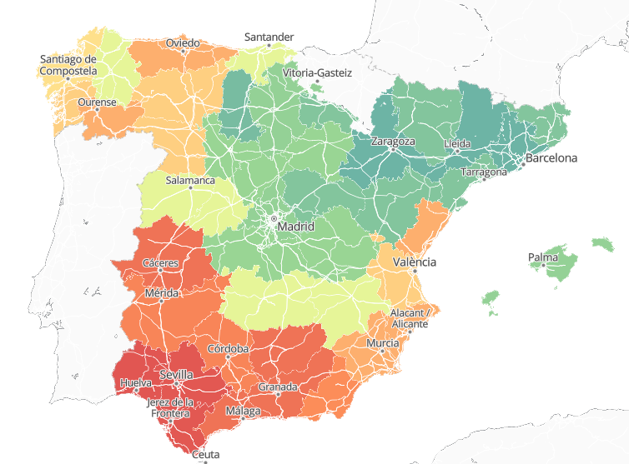
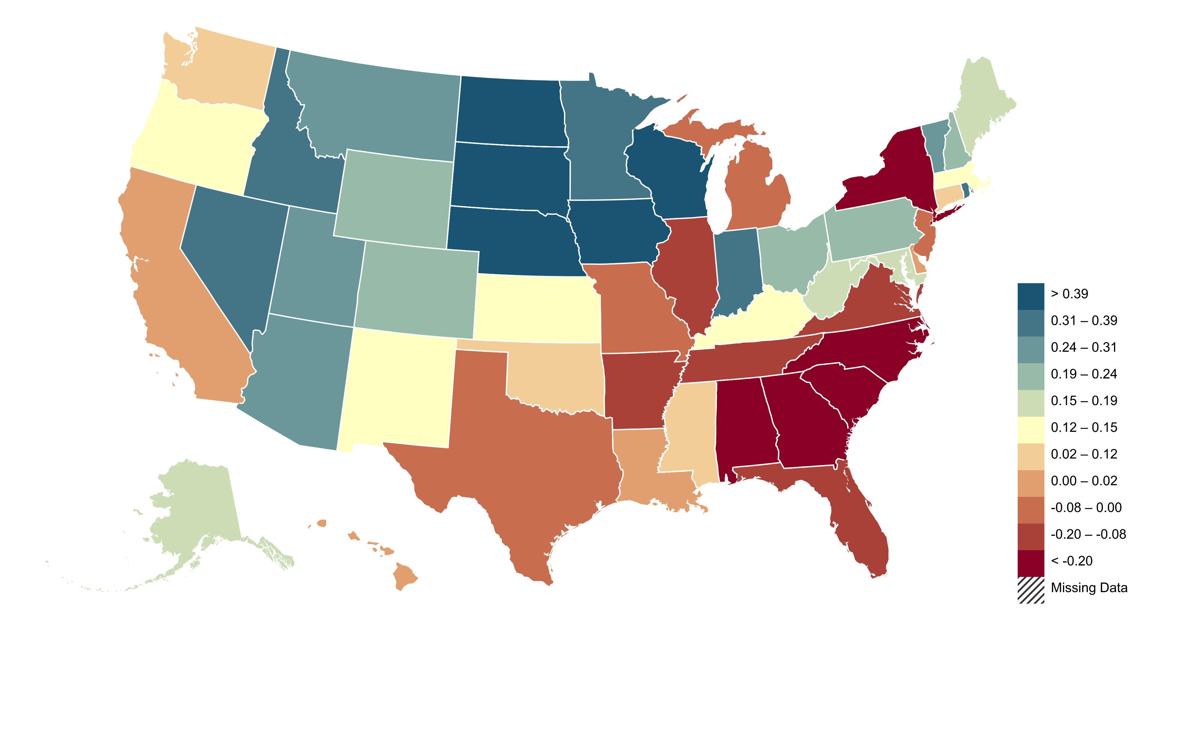
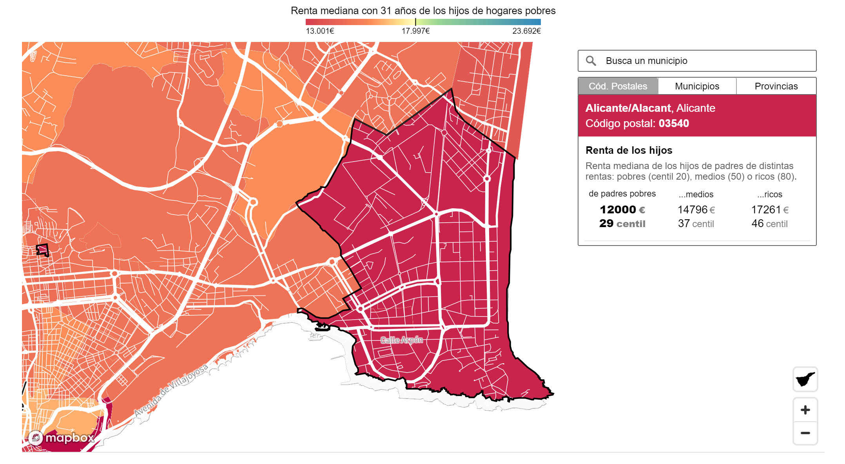
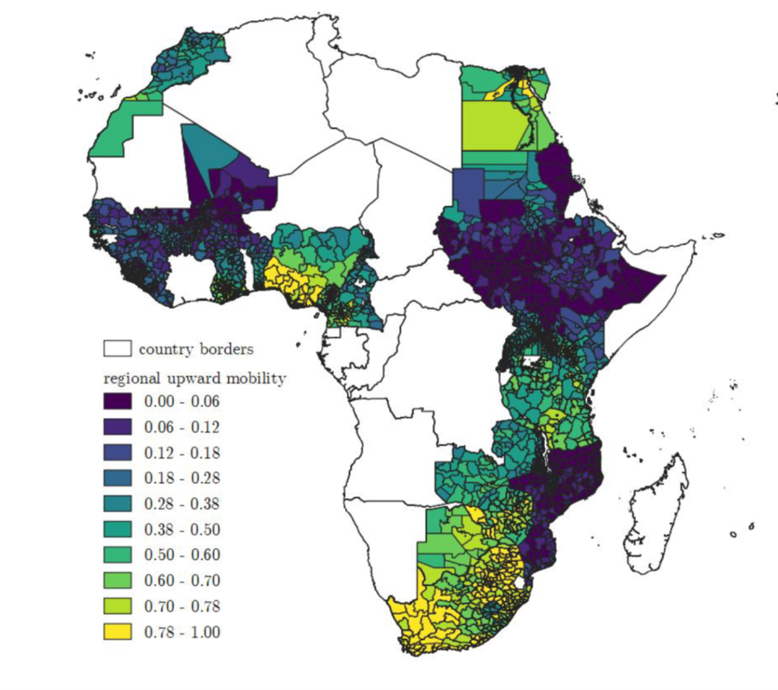
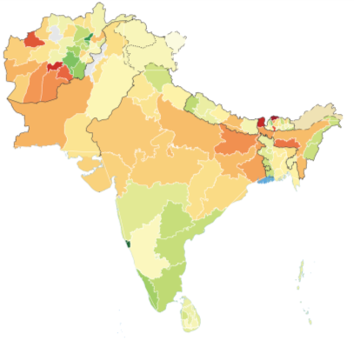

The Geography of Economic Opportunity Around the World
Sweden
Spain
Annual Individual Income
at Age 32-34 (2010)
Median Income at Age 31 for
Children from Low-Income Households
> 255,000 SEK
> 23.692 EUR
< 235,000 SEK
< 13.001 EUR
Africa
South Asia
Upward Mobility
Mean Education Rank for Children with Less-Educated Parents
(lowest)
58.0
(highest)
27.0
Source: Heidrich (2017); Atlas de Oportunidades (2020); Alesina, Hohmann, Michalopoulos, Papaioannou (2021); Asher, Bhowmick, Bussolo, and Novosad (2023)
Notes:
India, Pakistan, Afghanistan, Nepal, Bhutan, Bangladesh and Sri Lanka

